Slide 1
Multiple
Access

Slide 2
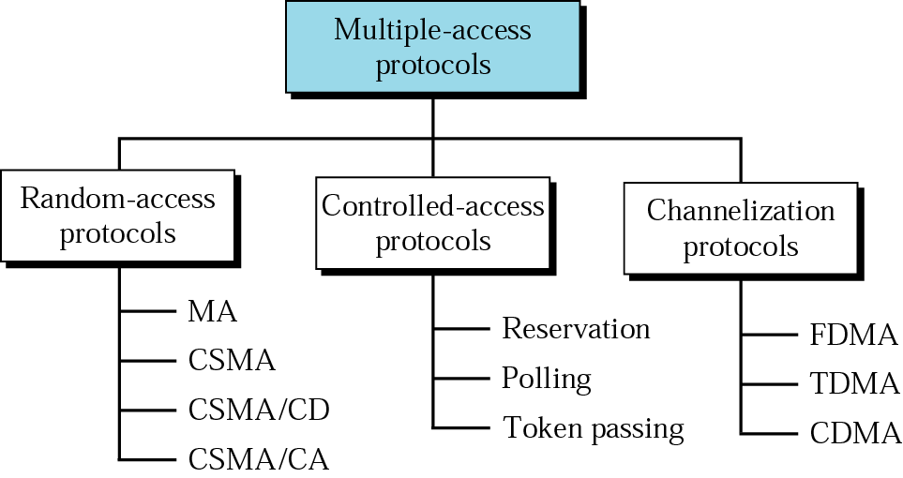
Figure 13.1 Multiple-access protocols

Slide 3
13.1 Random Access
MA
CSMA
CSMA/CD
CSMA/CA

Slide 4
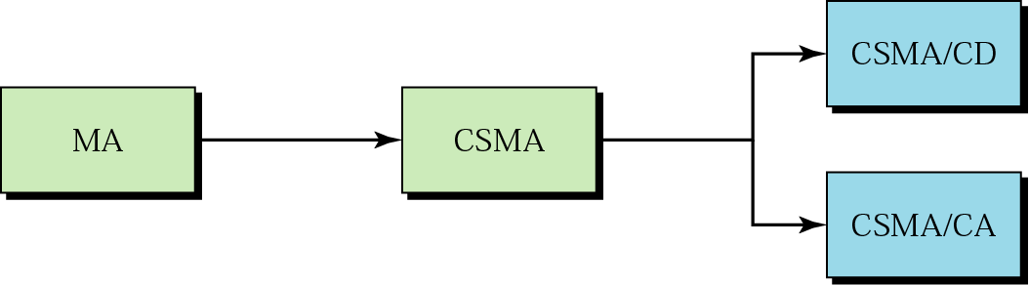
Figure 13.2 Evolution of random-access methods

Slide 5
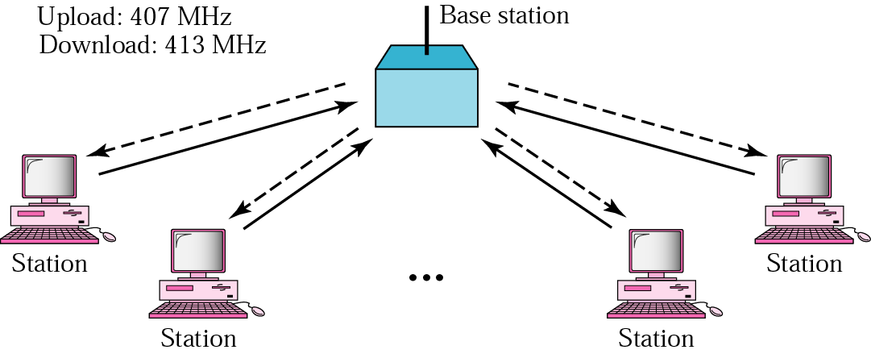
Figure 13.3 ALOHA network

Slide 6
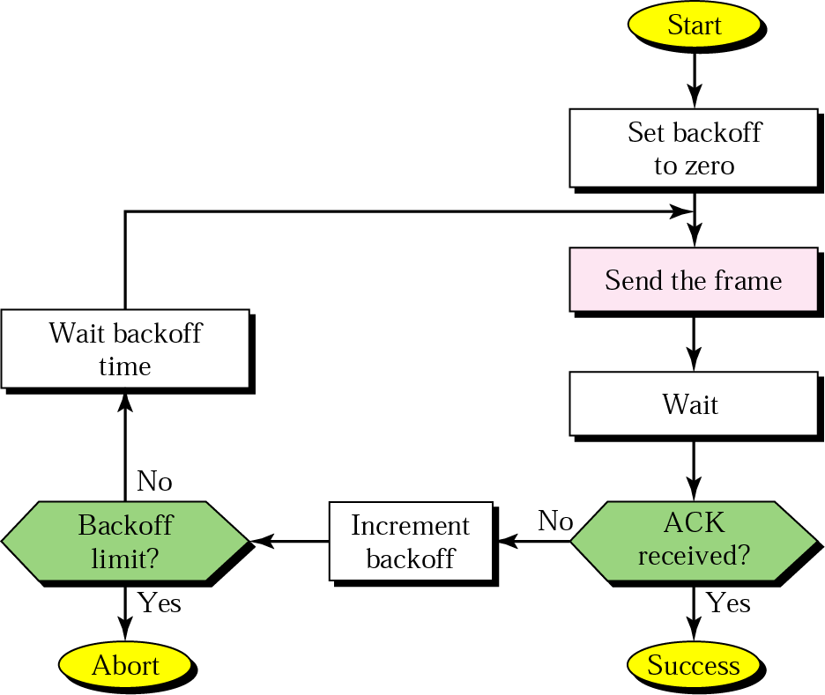
Figure 13.4 Procedure for ALOHA protocol

Slide 7
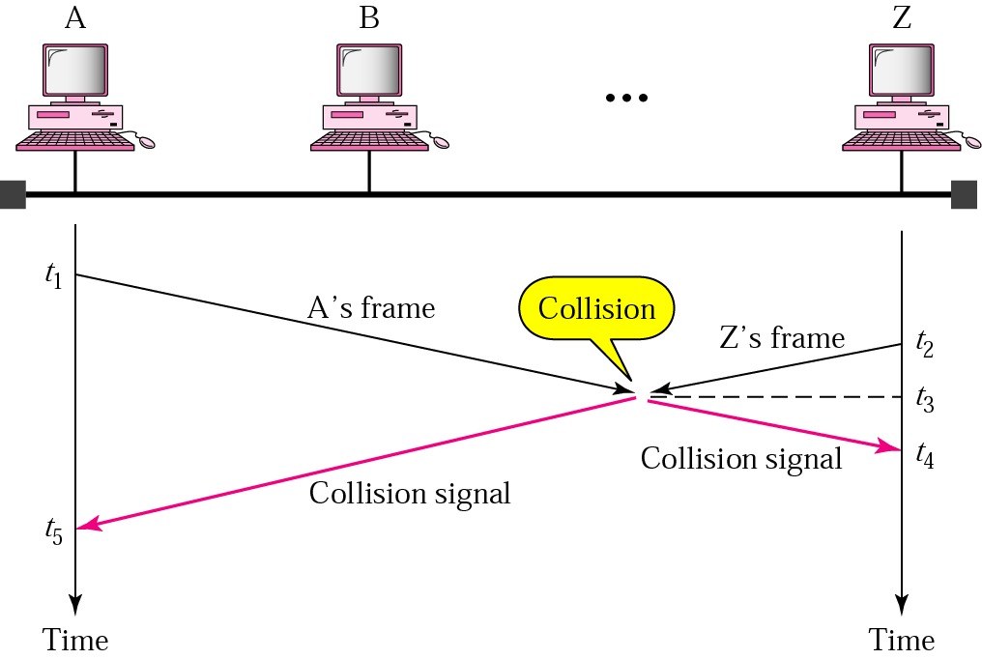
Figure 13.5 Collision in CSMA

Slide 8
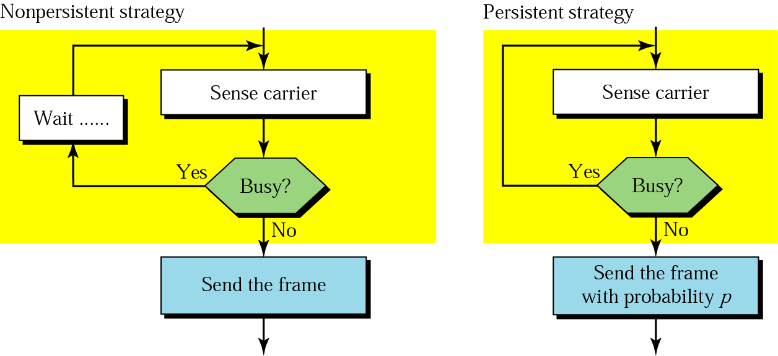
Figure 13.6 Persistence strategies

Slide 9
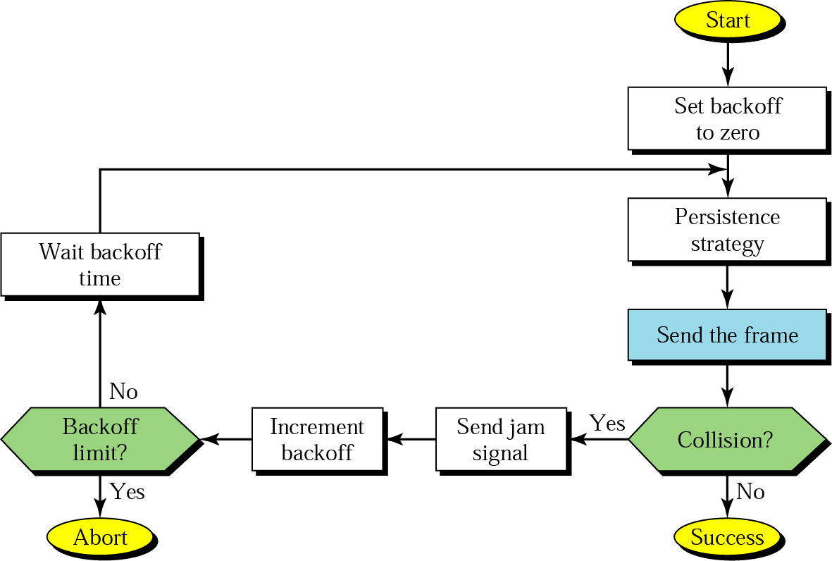
13.7 CSMA/CD procedure

Slide 10
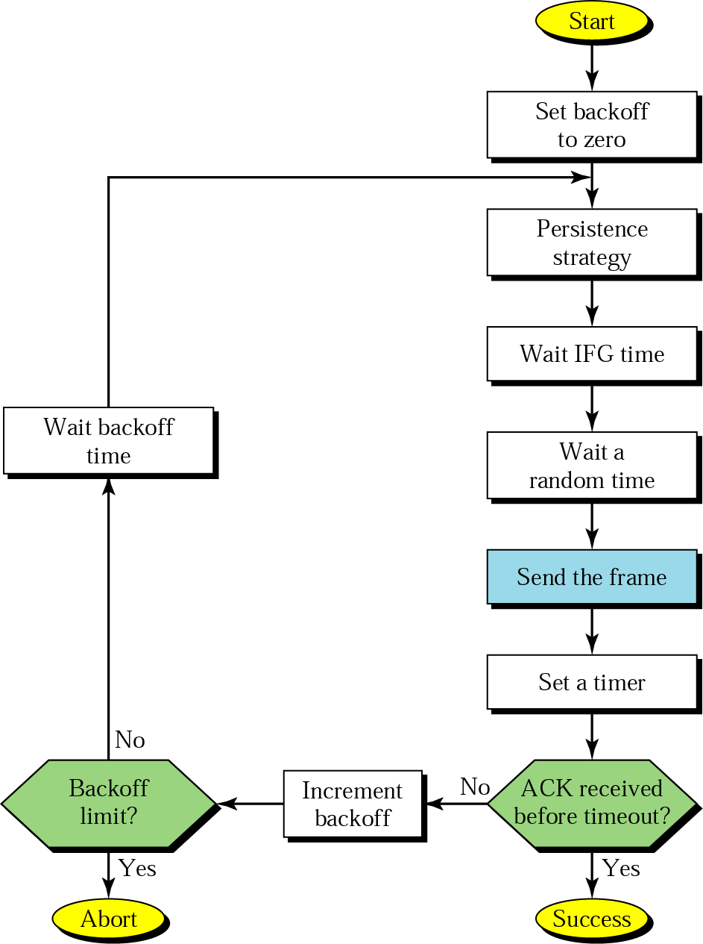
Figure 13.8 CSMA/CA procedure

Slide 11
13.2 Control Access
Reservation
Polling
Token Passing

Slide 12
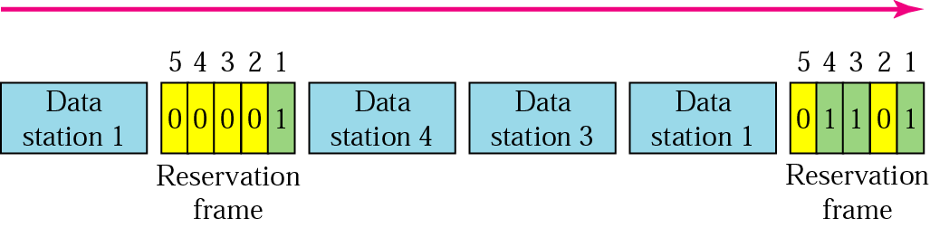
Figure 13.9 Reservation access method

Slide 13
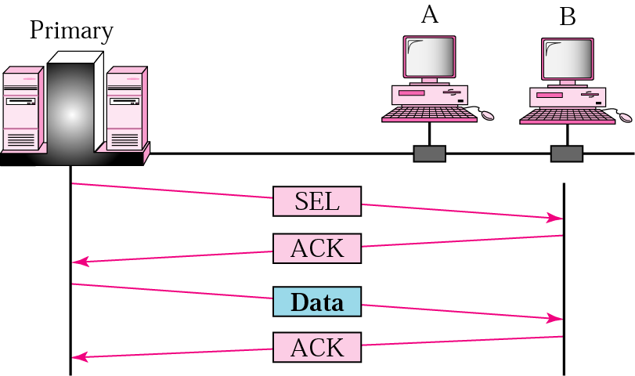
Figure 13.10 Select

Slide 14
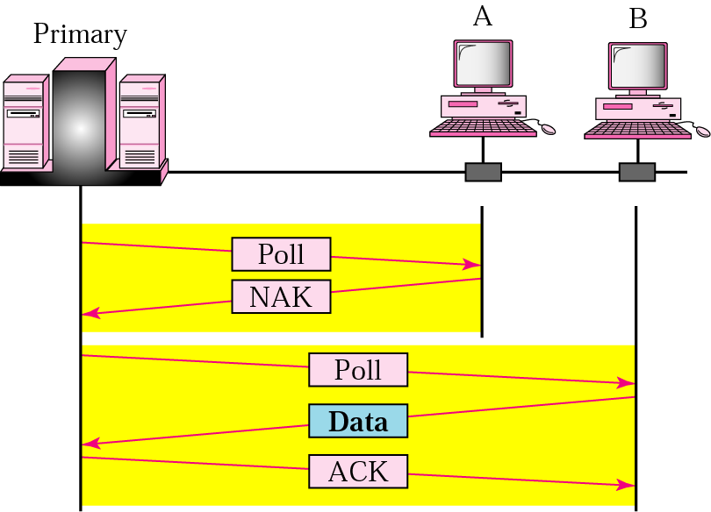
Figure 13.11 Poll

Slide 15
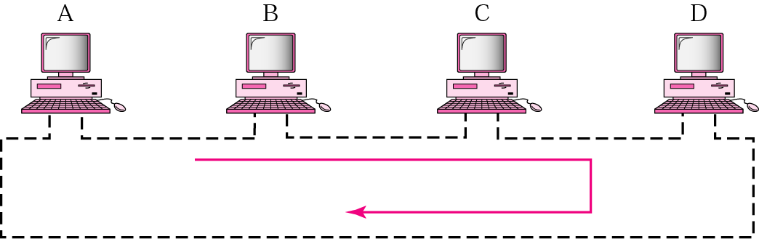
Figure 13.12 Token-passing network

Slide 16
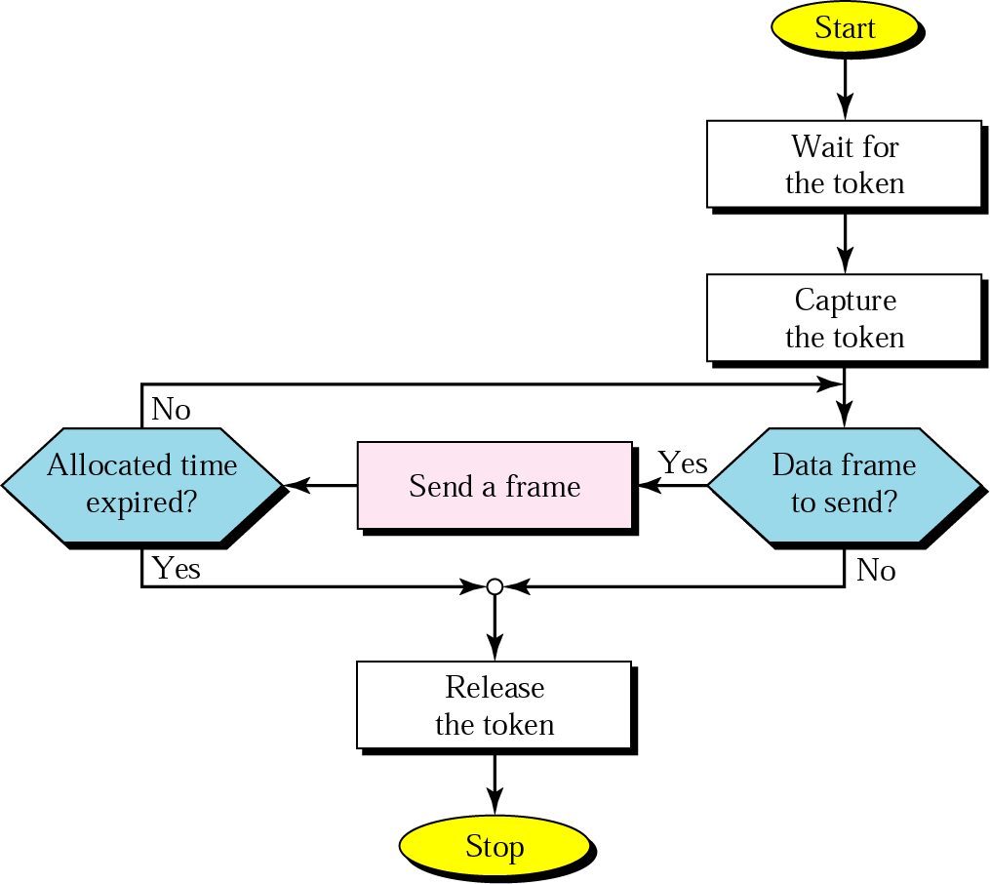
Figure 13.13 Token-passing procedure

Slide 17
13.3 Channelization
FDMA
TDMA
CDMA

Slide 18

Note:
In FDMA, the bandwidth is divided into channels.

Slide 19
Note:
In TDMA, the bandwidth is just one channel that is timeshared.

Slide 20
Note:
In CDMA, one channel carries all transmissions simultaneously.

Slide 21
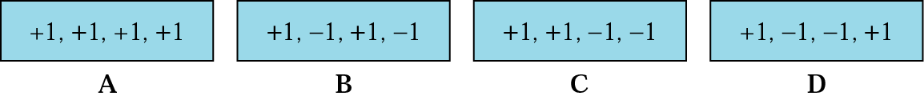
Figure 13.14 Chip sequences

Slide 22
Figure 13.15 Encoding rules

Slide 23
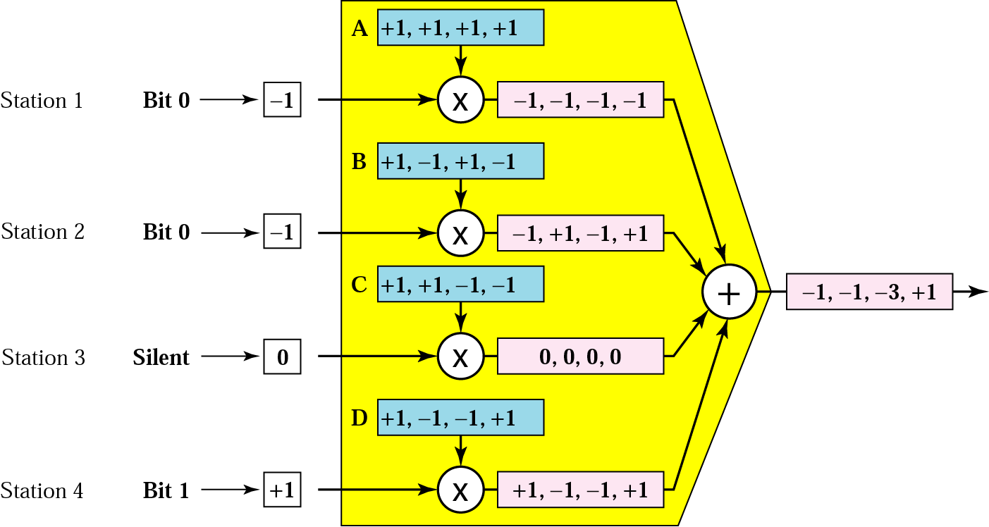
Figure 13.16 CDMA multiplexer

Slide 24
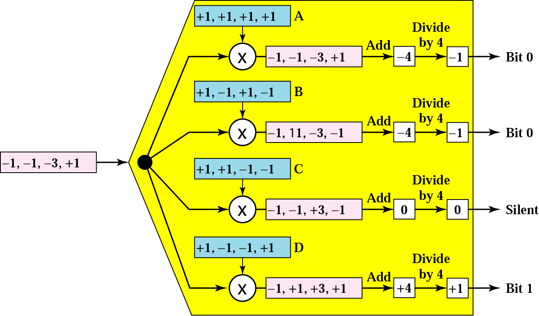
Figure 13.17 CDMA demultiplexer

Slide 25
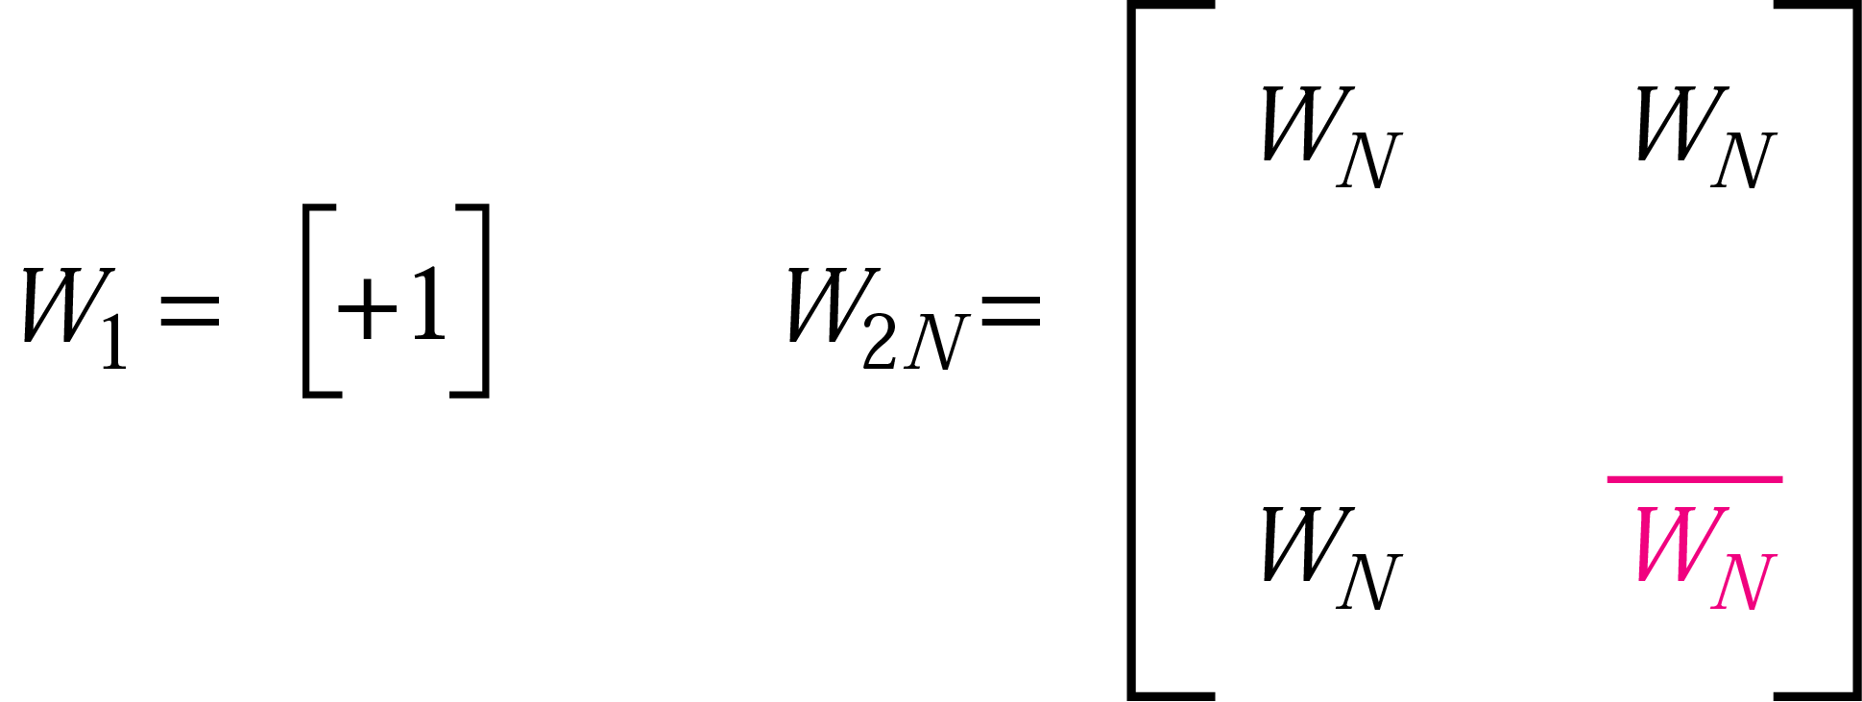
Figure 13.18 W1 and W2N

Slide 26
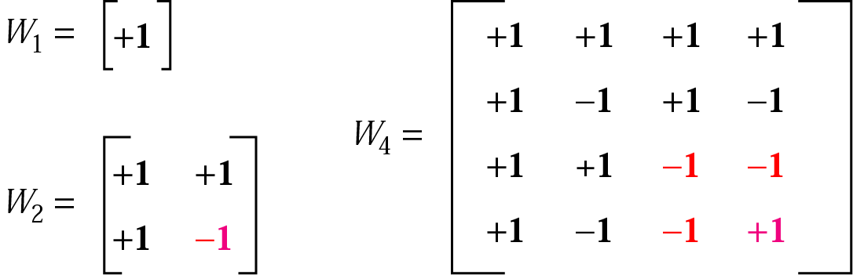
Figure 13.19 Sequence generation

Slide 27
Example 1
Check to see if the second property about orthogonal codes holds for our CDMA example.
Solution
The inner product of each code by itself is N. This is shown for code C; you can prove for yourself that it holds true for the other codes.
C . C = [+1, +1, −1, −1] . [+1, +1, −1, −1] = 1 + 1 + 1 + 1 = 4
If two sequences are different, the inner product is 0.
B . C = [+1, −1, +1, −1] . [+1, +1, −1, −1] = 1 − 1 − 1 + 1 = 0

Slide 28
Example 2
Check to see if the third property about orthogonal codes holds for our CDMA example.
Solution
The inner product of each code by its complement is −N. This is shown for code C; you can prove for yourself that it holds true for the other codes.
C . (−C ) = [+1, +1, −1, −1] . [−1, −1, +1, +1] = − 1 − 1 − 1 − 1 = −4
The inner product of a code with the complement of another code is 0.
B . (−C ) = [+1, −1, +1, −1] . [−1, −1, +1, +1] = −1 + 1 + 1 − 1 = 0

